Slide 1
Data Analytics
Portfolio Project
using YouTube API
Created by Vamshi Munukuntla

Slide 2



PROJECT OUTLINE
The Situation
You're hired as a data consultant for the School of Data Science, an online platform for project-based data science education.
SODS's first cohort needs students to submit data analytics portfolios.
Develop a Streamlit web app for users to input YouTube API key and favorite channels, allowing them to retrieve and download data as CSV.
The Assignment
The Objectives
Create a user-friendly Streamlit app for data gathering.
Produce instructional videos to guide students in obtaining API key and channel IDs.

Slide 3
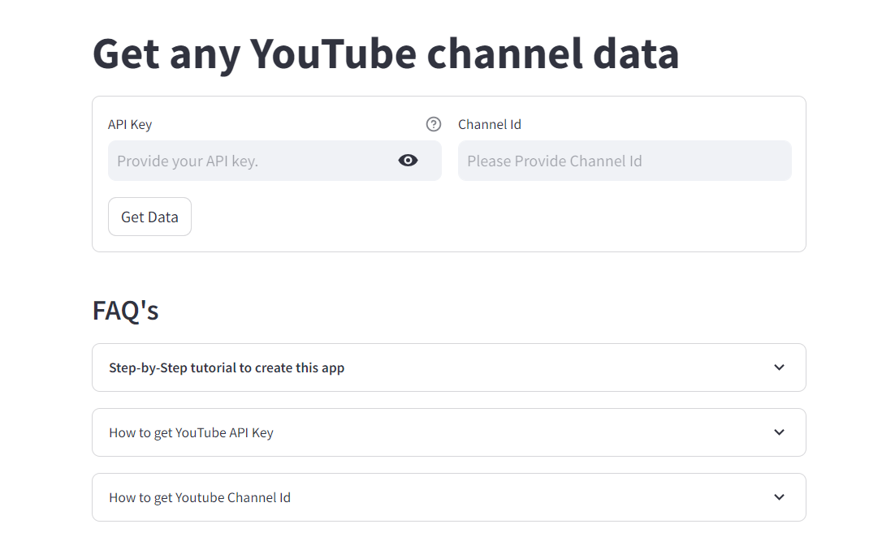
FINAL OUTPUT

Slide 4




TECH STACK
Python
YouTube API
Streamlit
Pandas

Slide 5

API
API (Application Programming Interface) is a set of rules and tools that allows applications to communicate and share data.
Request
Your Program
External System
Response
If Request is Valid, we get the data in JSON format.

Slide 6
API
Restaurant as a Metaphor
Request
Customer
Waiter
Chef
Response

Slide 7
API
How to get the YouTube API Key?

Slide 8
API
How to get any YouTube Channel Id ?

Slide 9
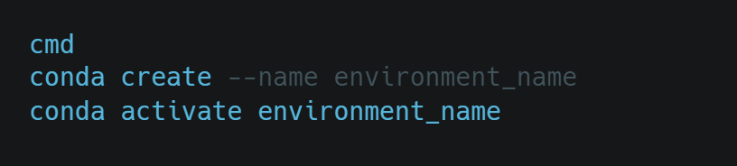
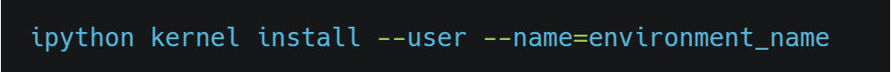
PROJECT SETUP
Creating a new virtual environment
Install IPython Kernel

Slide 10
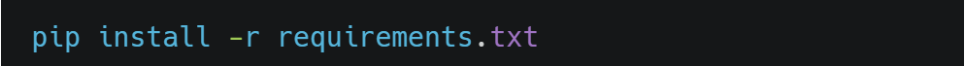

PROJECT SETUP
Install Requirements
Activate the environment

Slide 11
DATA RETRIEVAL PROCESS
Channels
End Point
Channel Statistics &
Playlist Id
Playlist Items
End Point
Videos
End Point
CSV
Video Meta Data
Video Ids

Slide 12
CHANNEL - END POINT
Items
Snippet
get_channel_data():
Getting JSON Response
Understanding get() method
Getting the Playlist Id and Statistics
Handling Exceptions
Title
Content Details
Related Playlists
Uploads
Statistics
View Count
Subscriber Count
Video Count

Slide 13
PLAYLIST ITEMS - END POINT
Items
Fetch_video_ids():
Getting JSON Response
Getting One Video Id
Getting Max Video Ids
Adding Page Token and While Loop
Handling Exceptions
Content Details
Video Id
Challenges:
At max, we can only retrieve 50 ids at a time
We need to use page Tokens to retrieve remaining ids
Using a While loop to extract all of the video ids

Slide 14
VIDEOS - END POINT
Items
Snippet
Title
Statistics
Description
View Count
Published At
Like Count
Tags
Favorite Count
Comment Count
Content Details
Duration

Slide 15
VIDEOS - END POINT
Get_video_meta_data()
Getting JSON Response
Getting Video Meta Data for 50 Items
Converting tags list to string
Getting all the video meta data
Handling Exceptions

Slide 16
STREAMLIT WEB APP
4 Functions
Inputs
Get Data
Download Data
Sidebar

Slide 17
ERROR HANDLING
Add Try and Except Blocks when necessary to mitigate any potential errors
Error Handling for Streamlit App
No API Key
Incorrect API Key
No Channel Id
Incorrect Channel Id
Channel with No Videos

Slide 18





MARKETING
GitHub
Project Description
LinkedIn Post & Add to Project Section
Article / Blog Post
Video Summary
Resume

Slide 19


Created by - VAMSHI MUNUKUNTLA
Follow me at:

